Slide 1

Filter Bubbles in Opinion Formation
Agent-Based Modeling and Social System Simulation

Slide 2
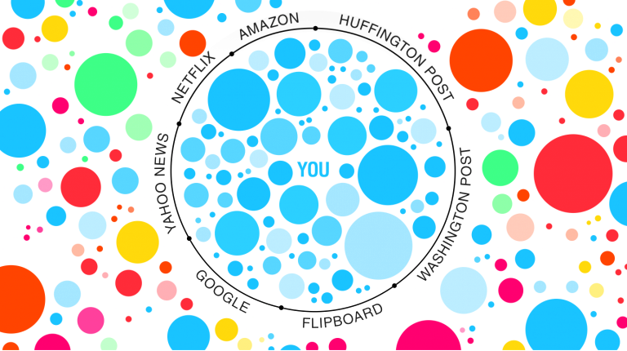
Introduction
Notes:
ADRIAN

Slide 3
Introduction & Motivation
”A filter bubble […] is a state of intellectual isolation that allegedly can result from personalized searches when a website algorithm selectively guesses what information a user would like to see based on information about the user, such as location, past click-behavior and search history.”
— Wikipedia
Notes:
ADRIAN

Slide 4
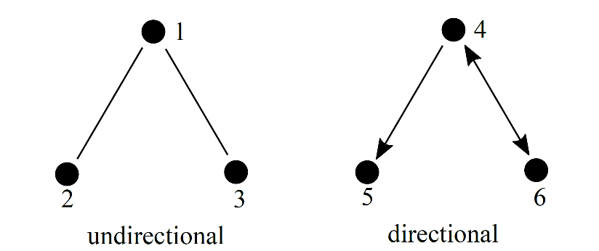
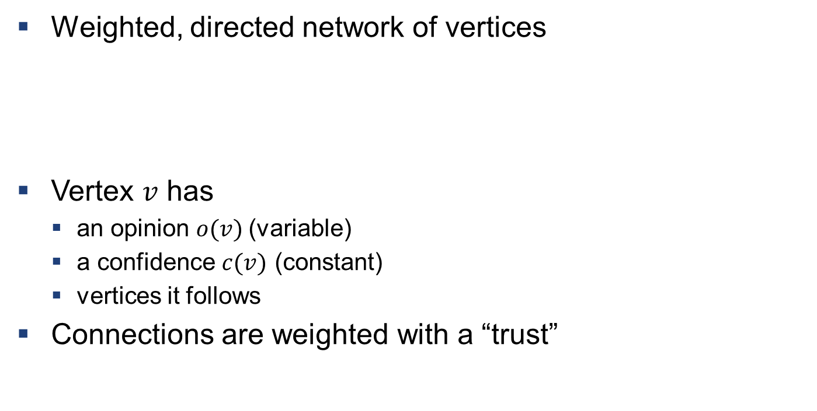
Description of the Model
Weighted, directed network of vertices
Vertex $v$ has
an opinion $o(v)$(variable)
a confidence $c(v)$ (constant)
vertices it follows
Connections are weighted with a “trust”
Notes:
BEAT

Slide 5
Following and Unfollowing
Vertex can “follow” and “unfollow” vertices
Stochastic model
probability to follow dependent on opinion difference
probability to unfollow dependent on the trust of the connection
Allows for the implementation of filter bubbles
Notes:
BEAT

Slide 6
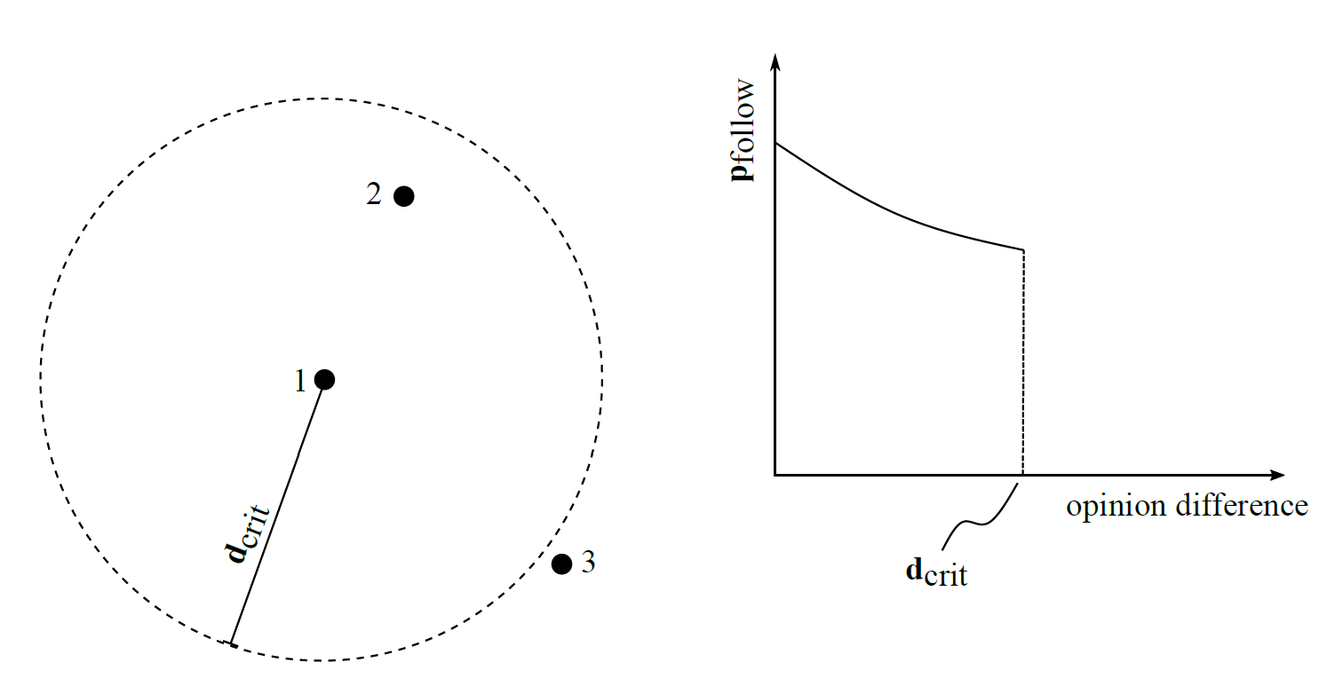
Notes:
BEAT

Slide 7
Implementation (Initialization)
Directed network $(V,A)$
Opinion:
$$o :V→\left[0, 1\right]$$
Confidence:
$$c :V→\left[0, 1\right]$$
Trust:
$$w :A→\left[0, 1\right]$$
Notes:
LEO

Slide 8
Implementation (Update values)
Opinion update:
$$o\left(u\right)←o\left(u\right)∙c\left(u\right)+(1−c\left(u\right))∙\sum_{\left(u, v\right)∈A}{w\left(u, v\right)⋅o(v)}$$
Trust update:
$$w\left(u, v\right)←w\left(u, v\right)+\left(1−α\right)⋅(c\left(v\right)−\left|o\left(u\right)−o\left(v\right)\right|)$$
Notes:
LEO

Slide 9
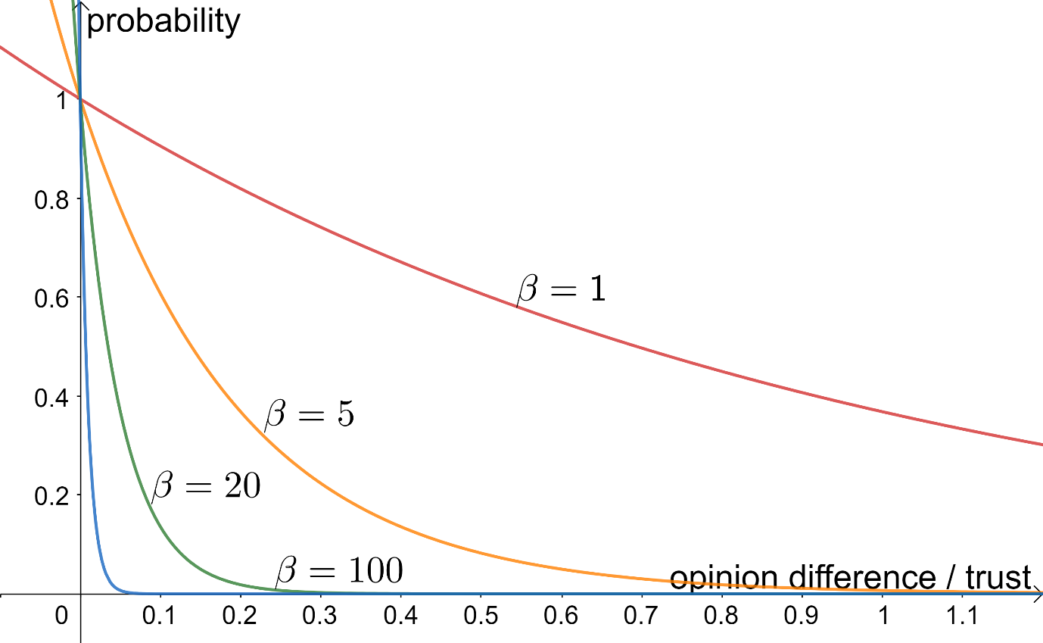
Implementation (Update connections)
$$p(x)=\text{exp}(−βx)$$
Delete connection $(u,v)$ with probability
$$p(w\left(u,v\right))$$
Build connection $(u,v)$ with probability
$$p(|o\left(u\right)−o\left(v\right)|)$$
Notes:
LEO

Slide 10
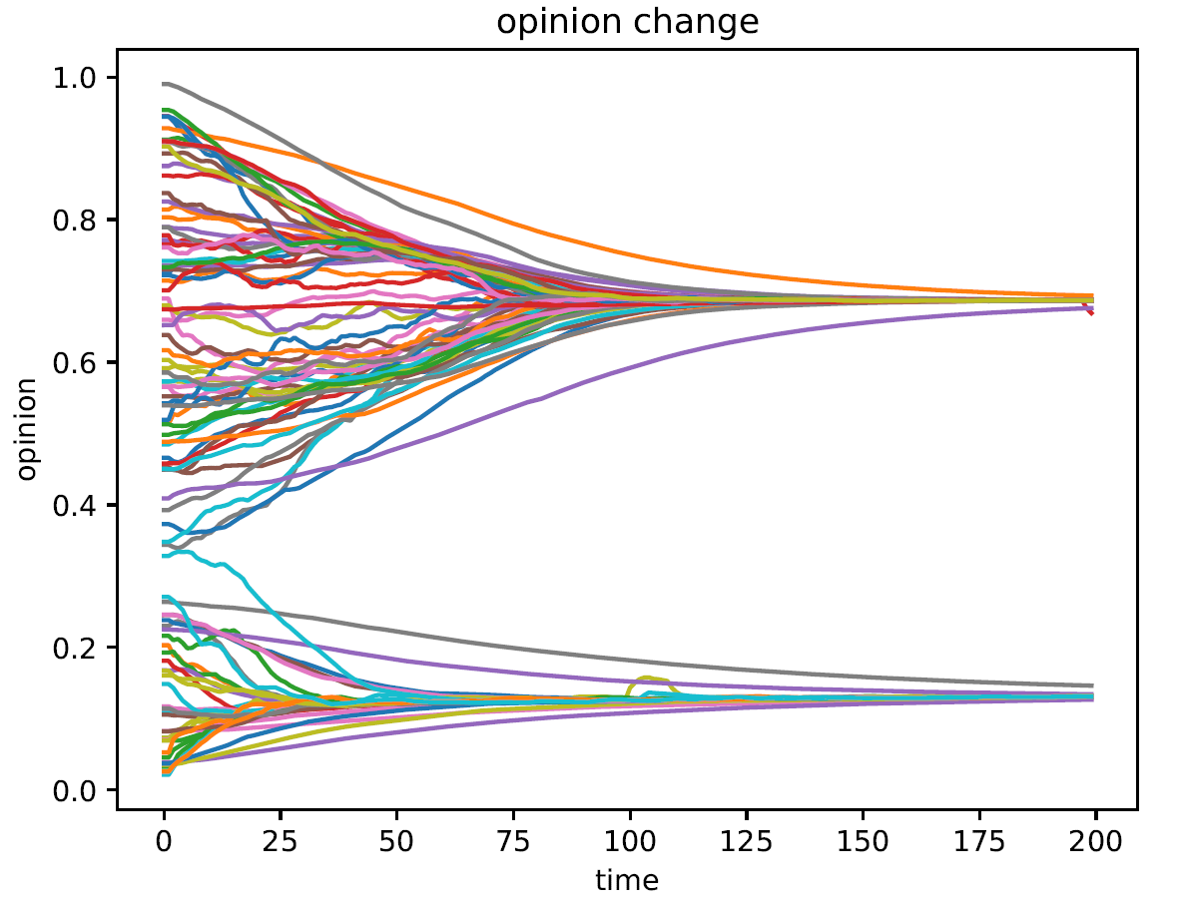
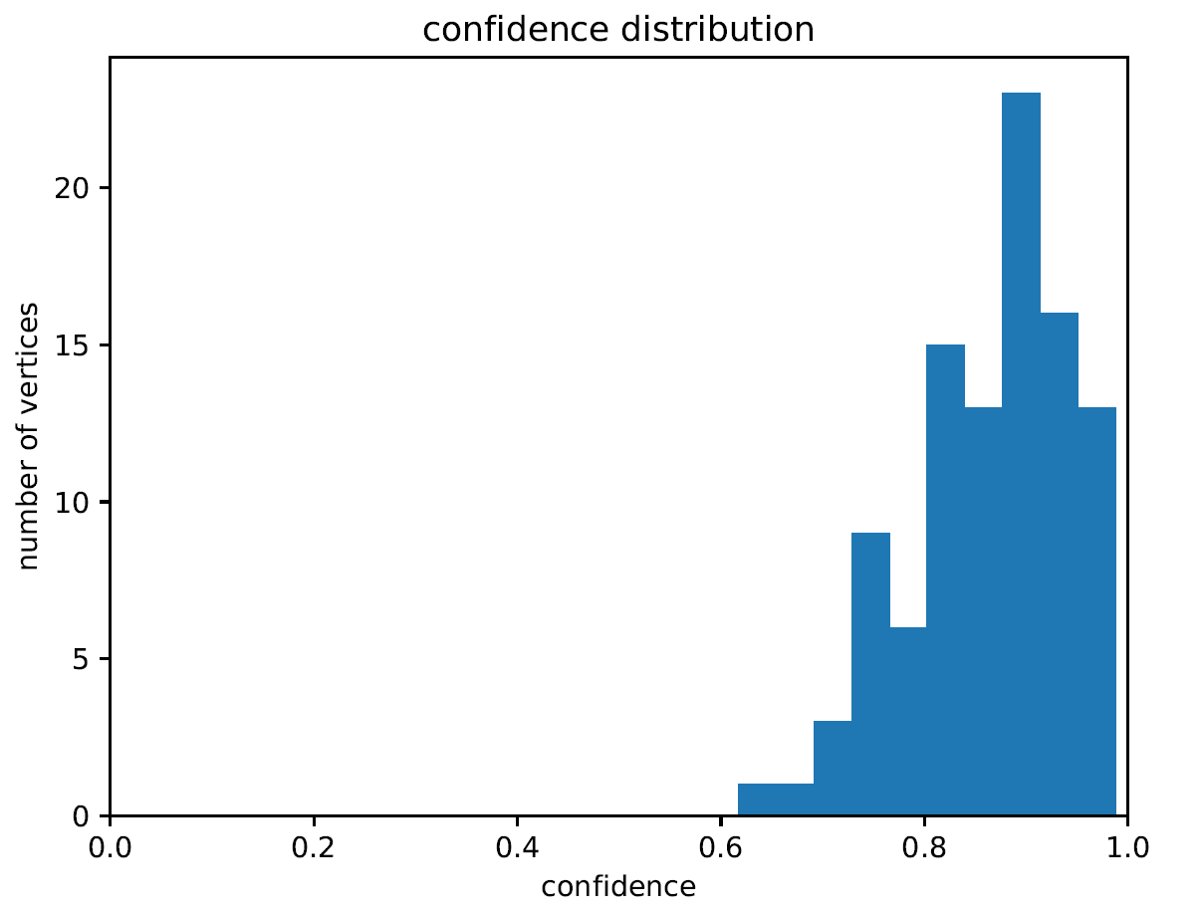
Initial Setup
bu = 20
bf = 20
confidence_mean = 0.9
confidence_std = 0.1
trust_stability = 0.99
Notes:
LUC

Slide 11
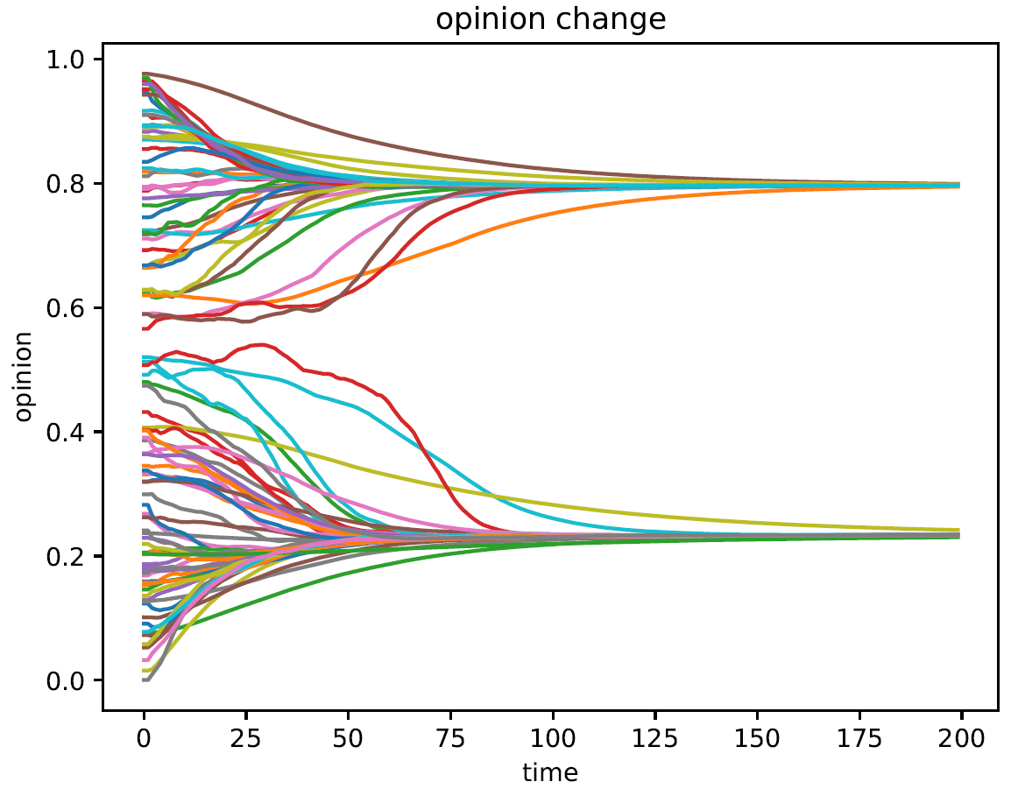
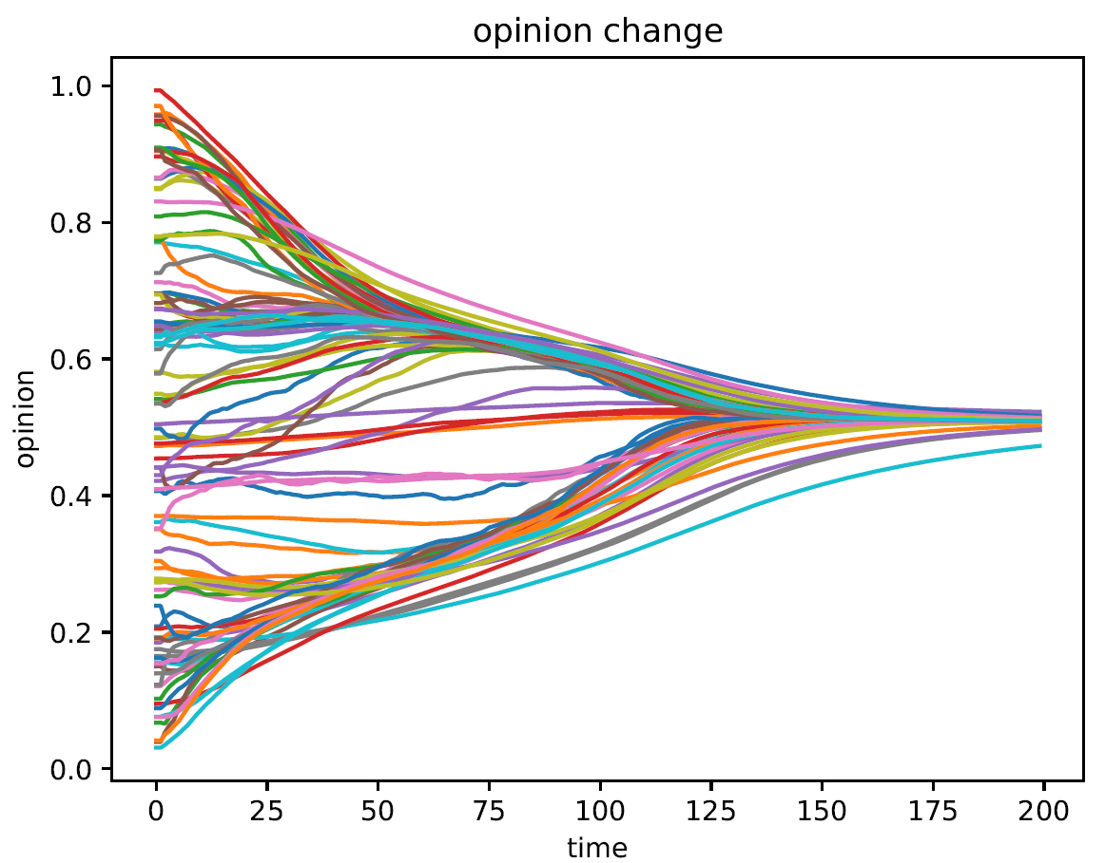
Influence of p_{follow} & p_{unfollow}
bu = 80
bu = 200
Notes:
LUC

Slide 12
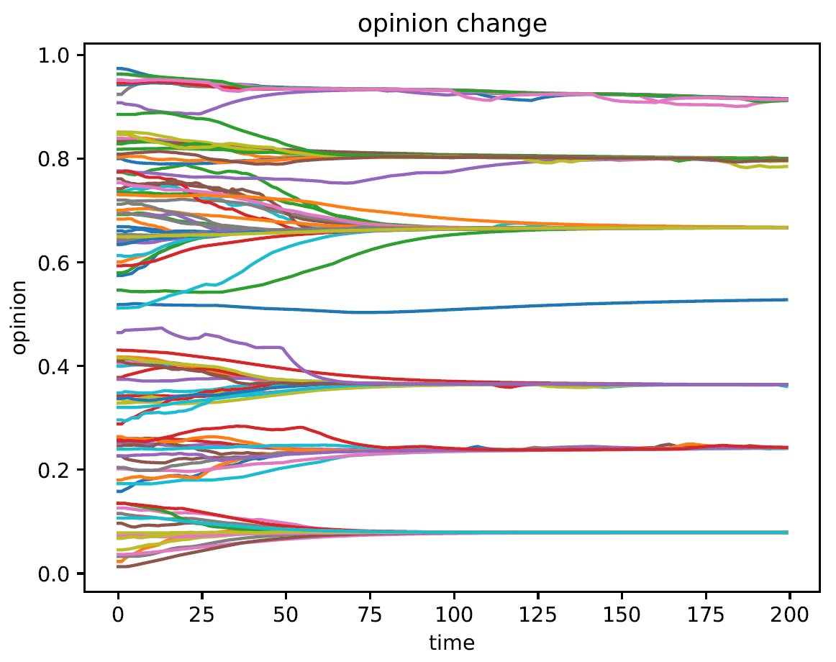
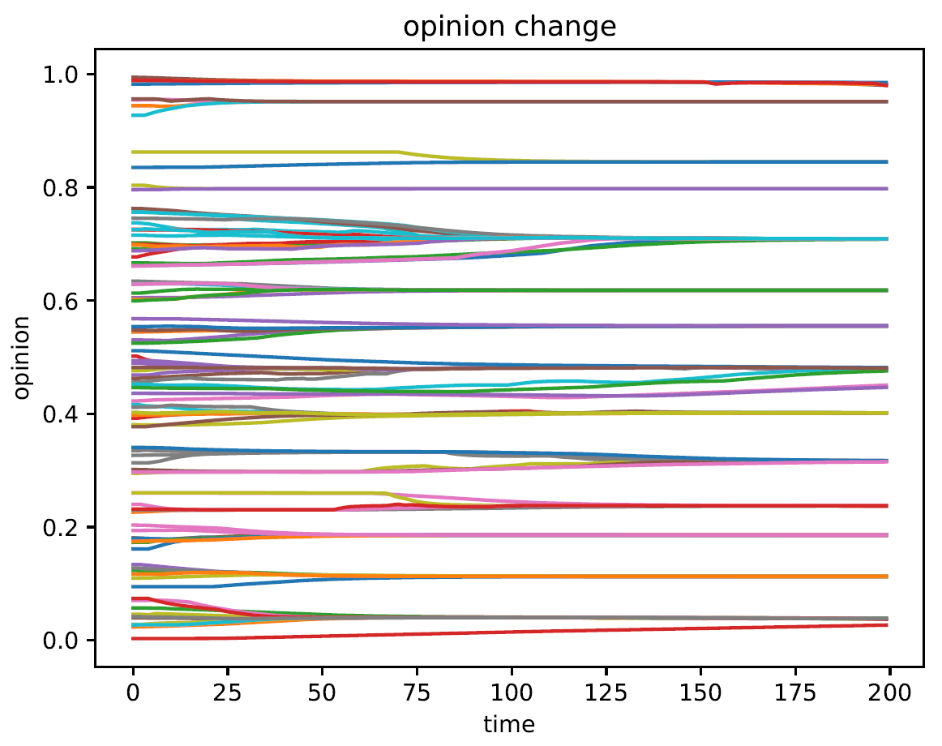
bf = 80
bf = 200
Notes:
LUC

Slide 13
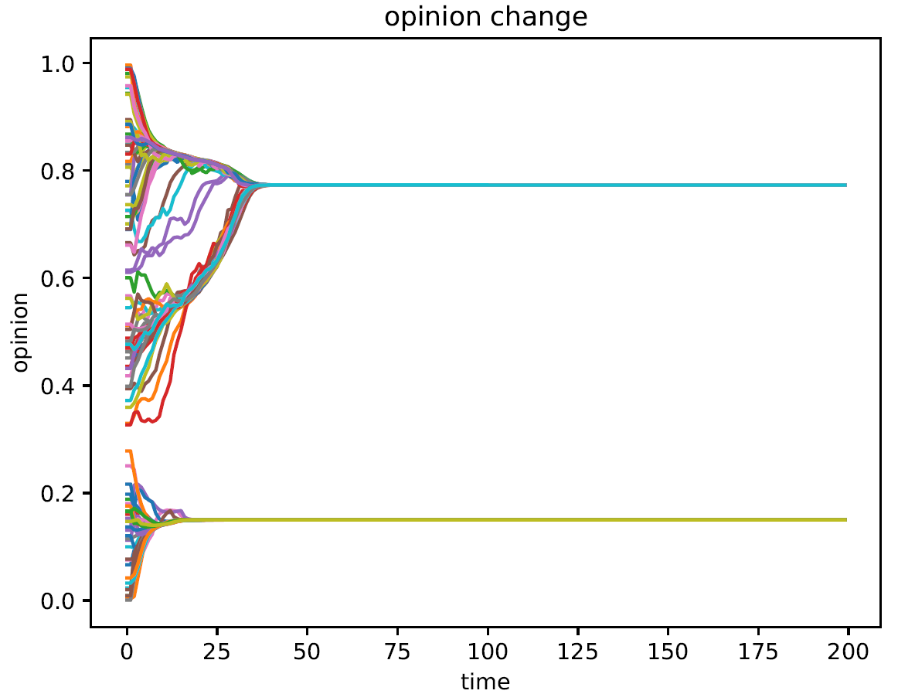
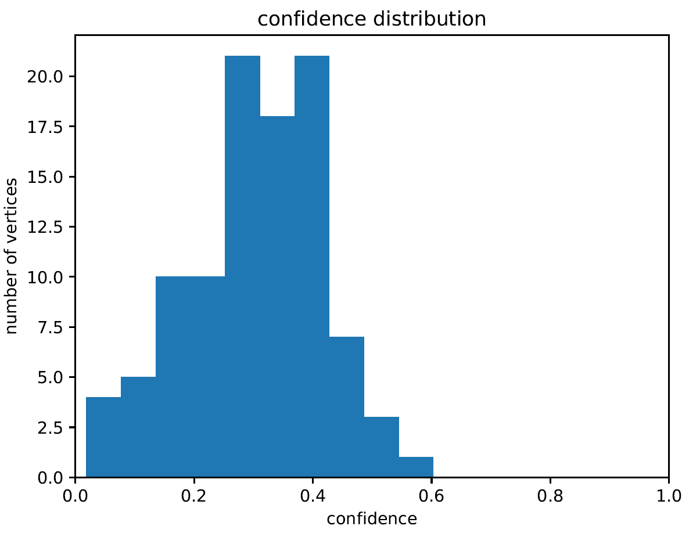
The confidence distribution
µ = 0.3
Notes:
LUC

Slide 14
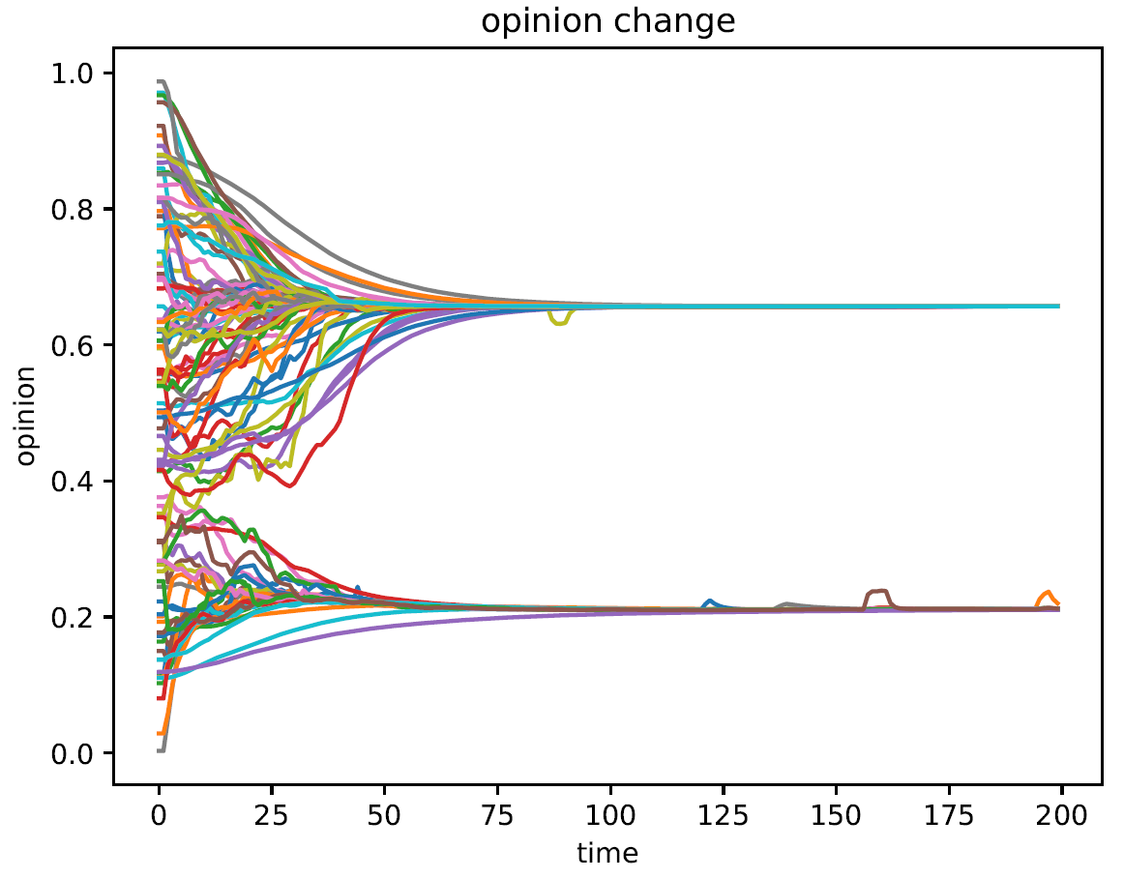
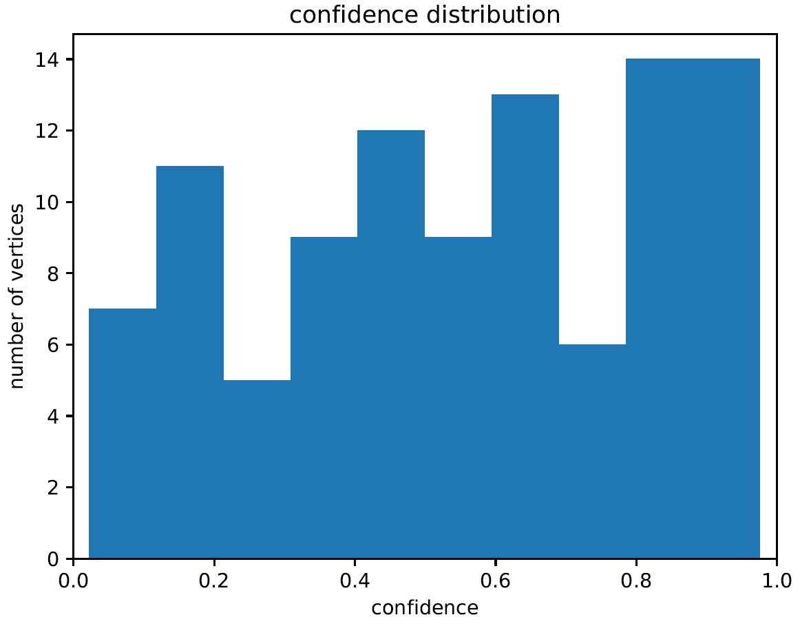
σ = 0.7
Notes:
LUC

Slide 15
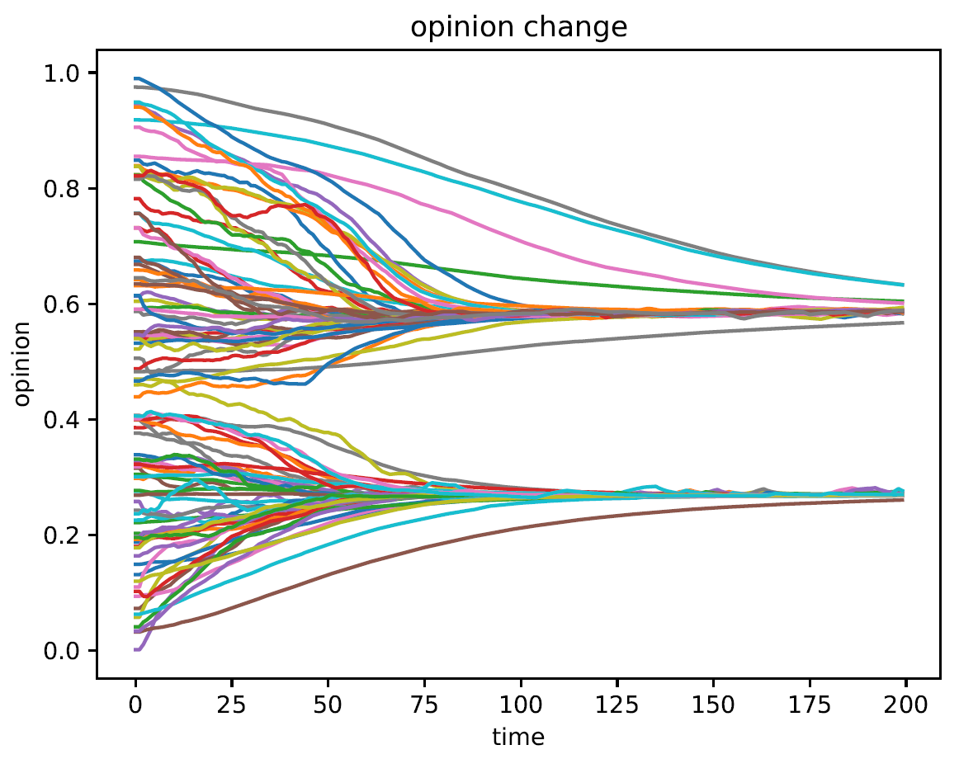
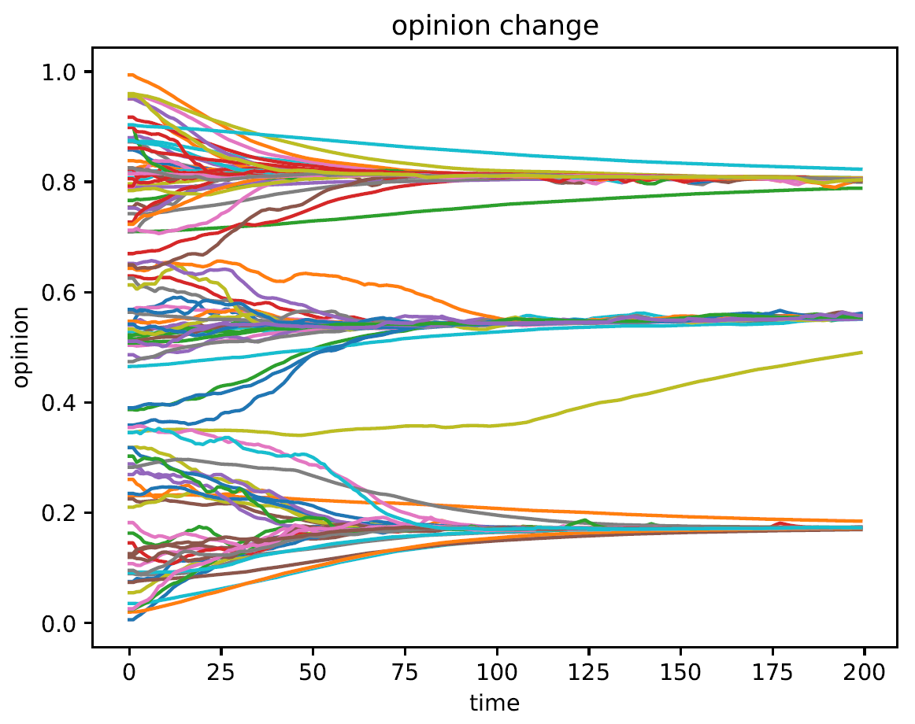
trust_stability
trust_stability = 0.5
Notes:
LUC

Slide 16
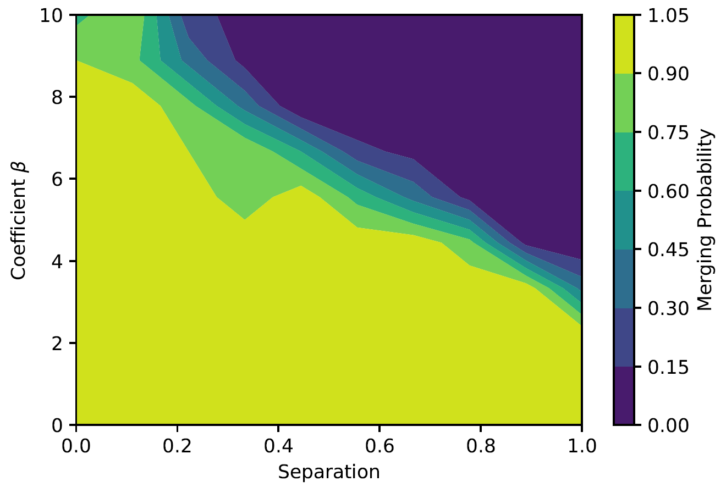
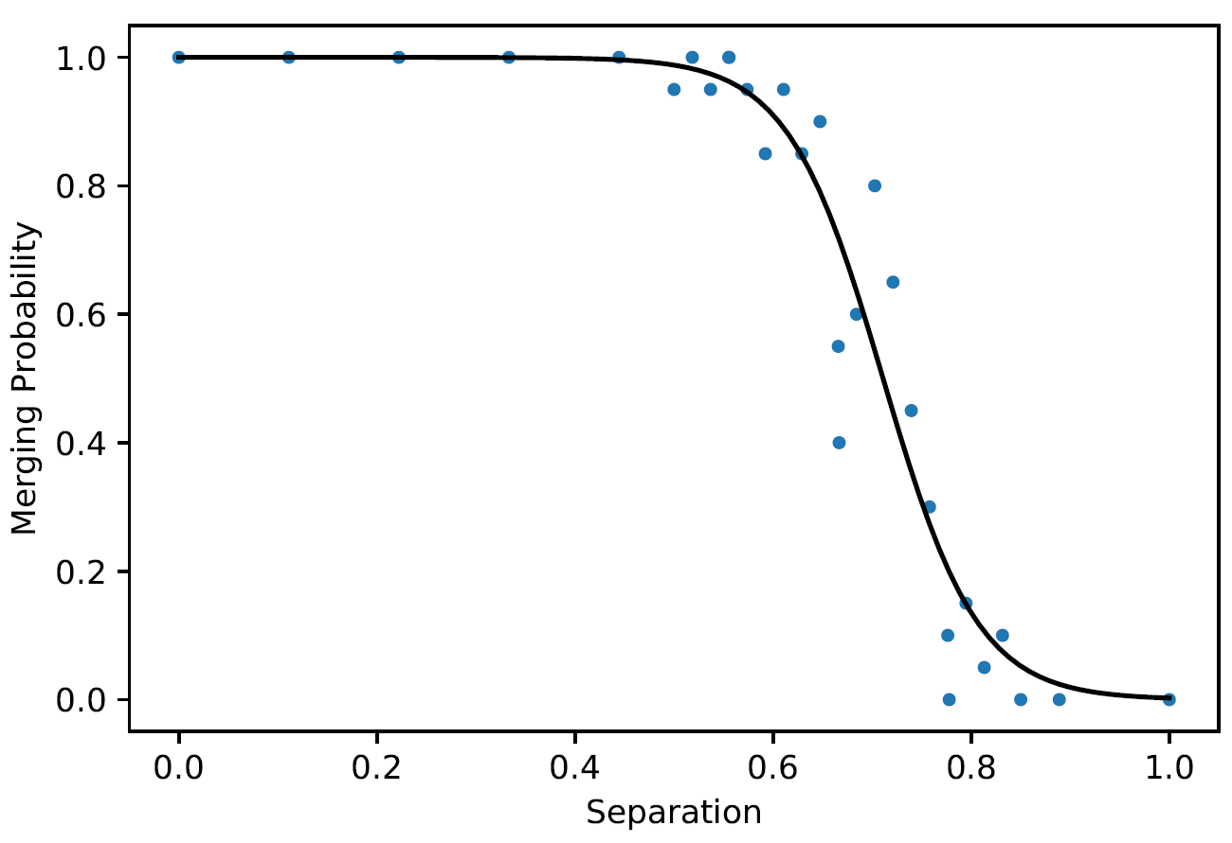
Convergence of Opinion Bubbles
Notes:
LUC
/BEAT

Slide 17
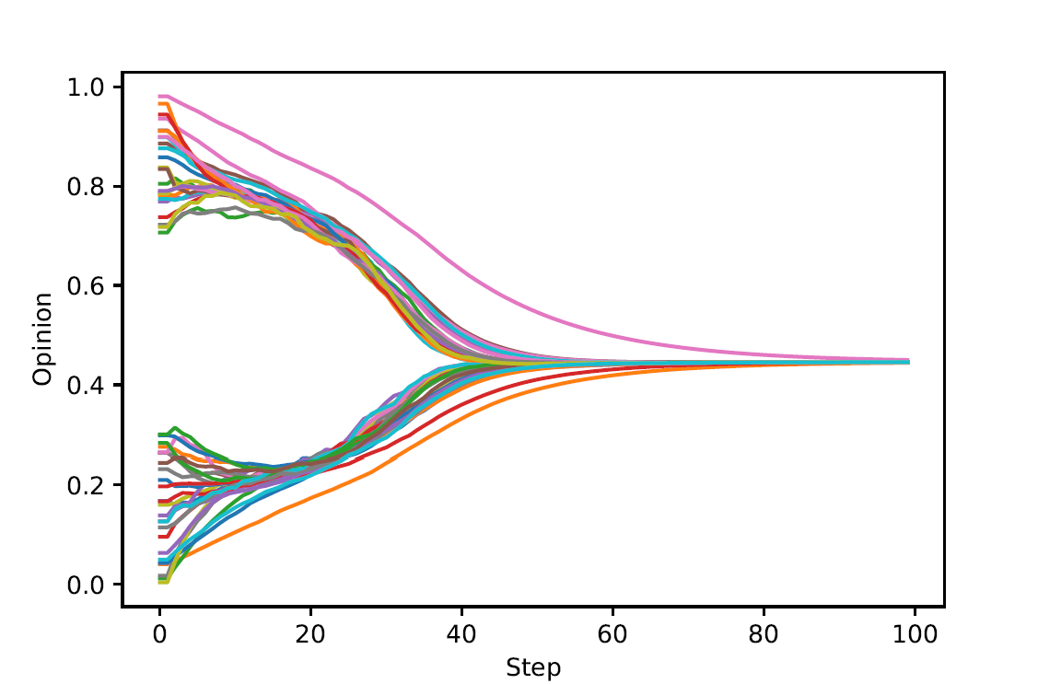
Merging of Opinion Strands
Initialise opinions with a separation → two initial bubbles
When do the strands merge?
Notes:
BEAT

Slide 18

FAQ

